Slide 1
Potential Expansion Based on Temperature Changes
Emma Mantel, Michael Airhart, Zabriel Adams, Bryan Oyuela

Slide 2
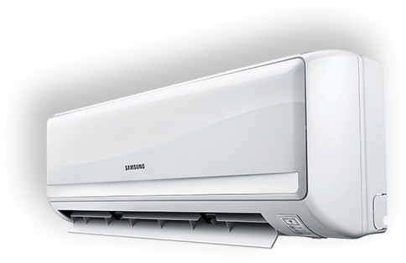
Business Objective
As a small manufacturer of Air Conditioning units, we are turning to this dataset to explore five domestic and five international cities that could potentially represent a new market given their temperature increases over the last 25 years.

Slide 3
The Dataset
Demographic: 154 US cities and 167 international cities from 124 countries
Years spanned: 1995 - 2020 (partially)
region | country | state | city | month | day | year | avgtemperature
Africa | Algeria | NaN | Algiers | 1 | 1 | 1995 | 64.2
Middle East | Turkey | NaN | Ankara | 1 | 14 | 1995 | 41.2
... | ... | ... | ... | ... | ... | ... | ...
North America | US | Washington | Spokane | 1 | 18 | 2020 | 26.9
North America | US | Washington | Spokane | 1 | 19 | 2020 | 32.8
2826652 rows × 8 columns
Data Source: http://academic.udayton.edu/kissock/http/Weather/default.htm

Slide 4
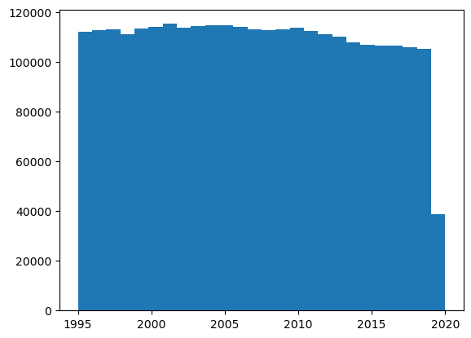
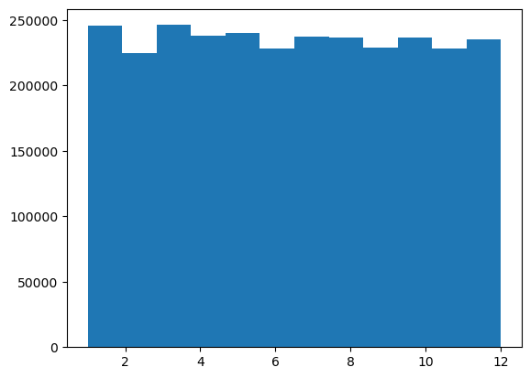
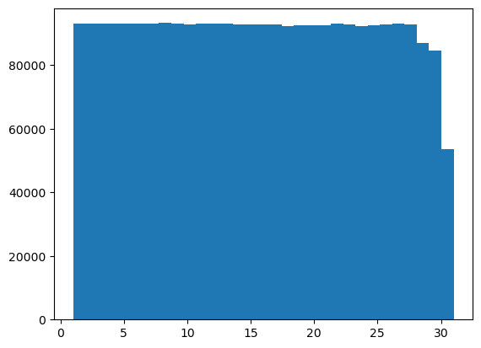
Data Cleaning
3 main faults in the data:
Some temperatures were set to “-99”, which may have accounted for missing data
Some of those “-99” days also had the year incorrectly entered as “201”
Certain days were indicated as day “0”
These data were removed, resulting in 79,672 out of 2,906,327 rows removed (2.74%).
Lastly, the data for 2020 is only included up to and including the month of May.
Robustness: through histograms of each date category we were able to confirm that no single day, month, or year was grossly over- or underrepresented

Slide 5
Procedure
To get a more robust measure:
Took the average of the first 5 years and the averages of the last 5 years in the dataset. Then, we obtained an average temperature increase for the summer months by taking the difference
Ranked cities by largest average temperature increase
Selected 10 cities as potential candidates for market expansion (global and domestic)

Slide 6
Results
After ordering the cities (5 international cities and 5 domestic cities) by biggest temperature increase, we narrowed our search to the following 10 candidate cities in no particular order:
Grand Junction, Colorado
Milan, Italy
Pueblo, Salt Lake City
San Angelo, Texas
Denver, Colorado
Madrid, Spain
Zagreb, Croatia
Salt Lake City, Utah
Belgrade, Serbia
Bishkek, Kyrgyzstan
Dubai, United Arab Emirates (Was in top 10, but excluded due to extreme heat)
Color Legend
International
Domestic (US)

Slide 7
Temperature Filtering
After looking over the list we created, we decided to refine our search further. This includes the following parameters:
Remove from list if city is relatively cool (Average temperature < 75 degrees)
A city that could still be too cool for AC may not help us maximize our sales.
This excludes Denver, Colorado.
Remove from list if city is too hot (Average temperature > 85 degrees)
A city that is already too hot is more likely to already have a saturated AC market
This excludes Dubai, United Arab Emirates

Slide 8
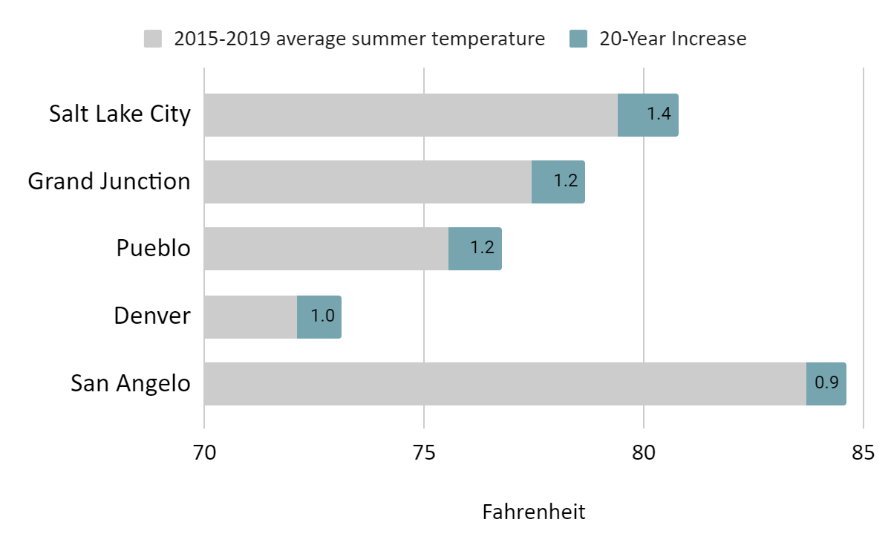
Candidate Domestic Cities
* Denver does not quite meet our temperature requirement
Notes:
The takeaway from this slide is a visual representation of the temperature increase, and also of the mean summer temperature in the past 5 years, illustrating our selection criteria, to get a sense for possible demand in the area

Slide 9
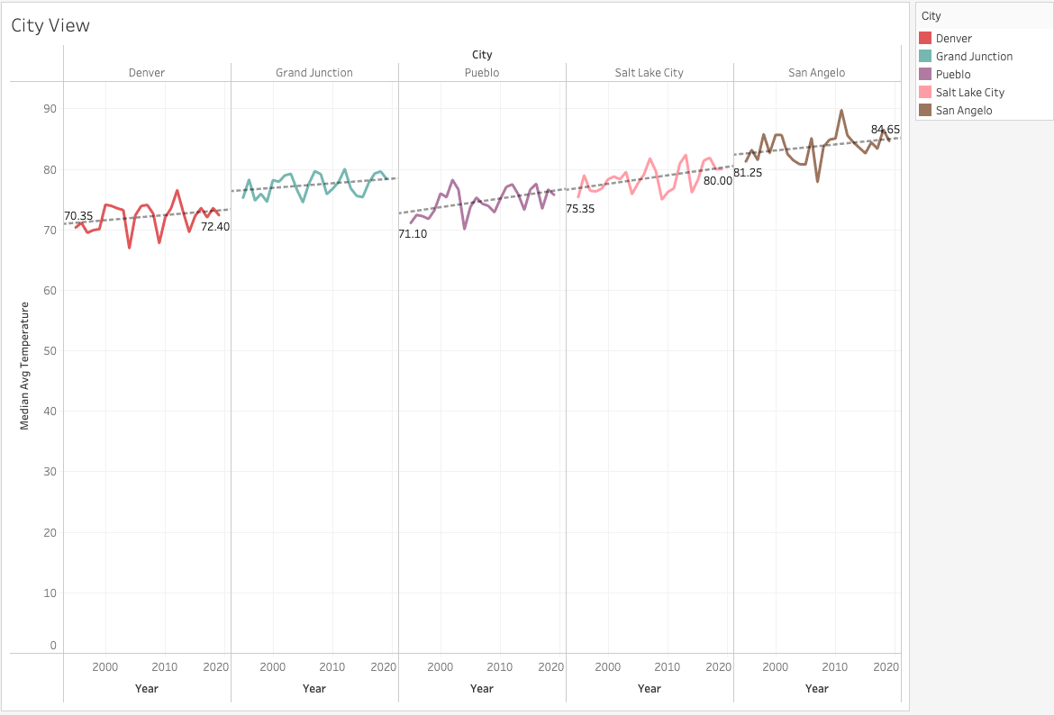

Slide 10
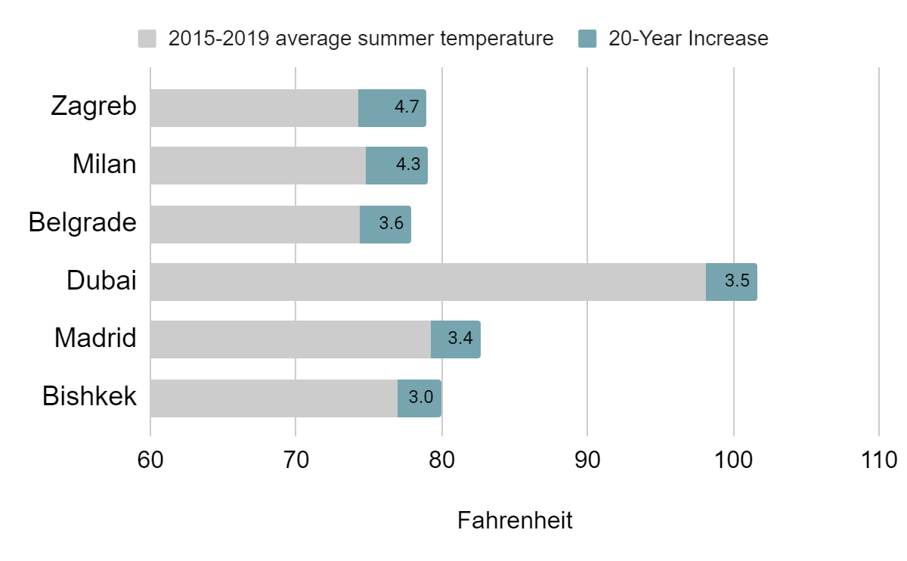
Candidate International Cities
* Dubai was excluded
Notes:
The takeaway from this slide is a visual representation of the temperature increase, and also of the mean summer temperature in the past 5 years, illustrating our selection criteria

Slide 11
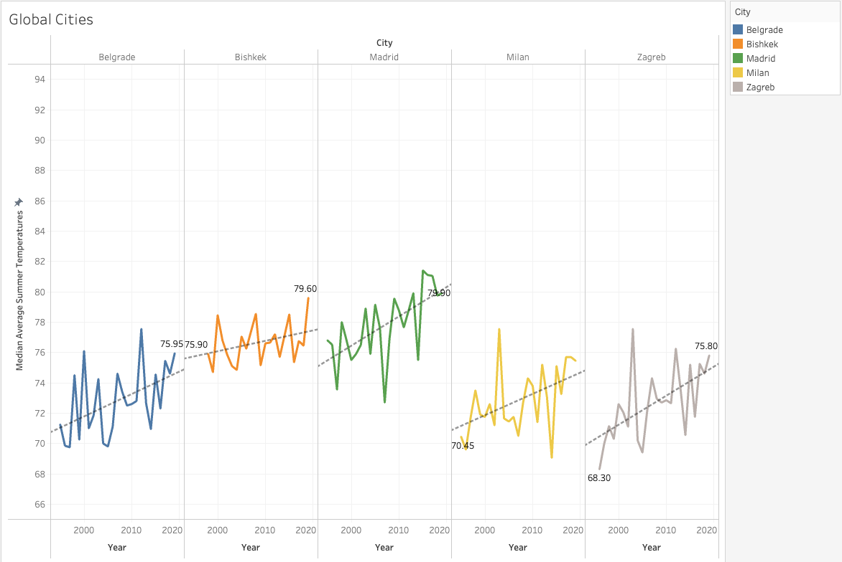

Slide 12
Could Denver Fit Our Criteria Eventually?

Slide 13
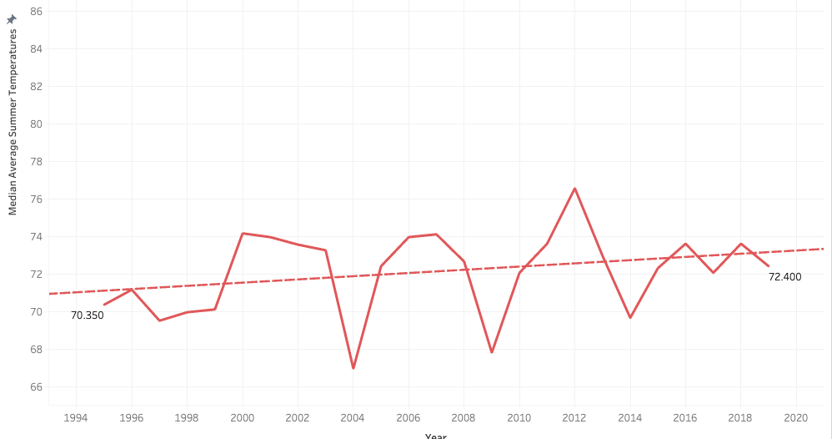
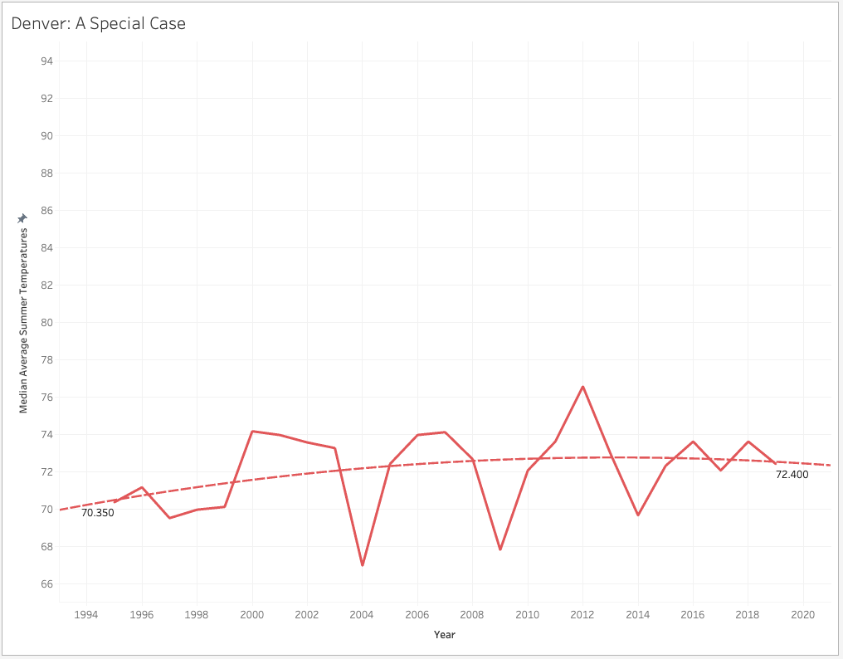
Temperature Prediction: Linear Regression
Denver is unlikely to reach our threshold in the future.
Notes:
Based on the regression, Denver is unlikely to reach the threshold in the next couple of years

Slide 14
Further Analysis to Narrow the Options

Slide 15
Lots of Options, But Not All Are Feasible
After narrowing our list to ten cities, we realized that expansion to each of these would still be a massive undertaking. To deal with this, we conducted further analysis to find 3 realistic choices for our expansion. We went about this by:
Deciding on an additional metric: the standard deviation of the temperature in the summer months
Creating combination charts and bar graphs to visualize those metrics
Ranking the cities according to those metrics for our final recommendation

Slide 16
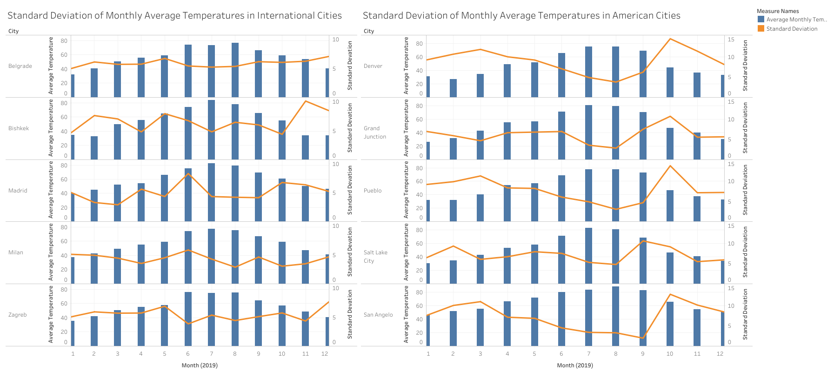
Combination Chart
Notes:
This shows the average temperature for each month over the most recent full year and associated standard deviations in temperature for each month. Our key insight was to identify which cities have summer months that are consistently warm, and thus people are likely to purchase AC, instead of having a few hot days that are outliers.

Slide 17
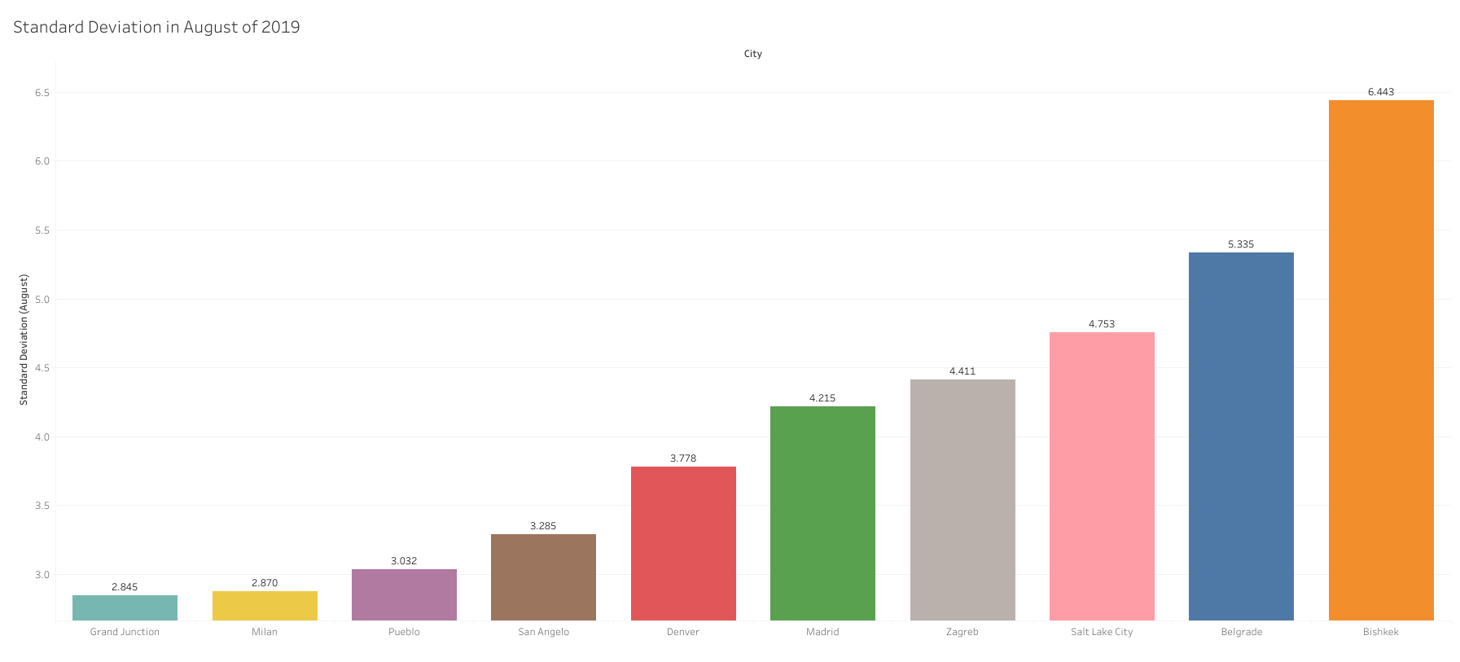
Standard Deviations in Order
Notes:
A closer look at the standard deviations in temperature for AUgust of 2019, which was the hottest month in all cities, showing that Grand Junction, Milan, Pueblo, San Angelo seem to be very consistently warm in the summer
Grand Junction, Milan, Pueblo, San Angelo, Denver, Madrid, Zagreb, Salt Lake City, Belgrade, Bishkek

Slide 18
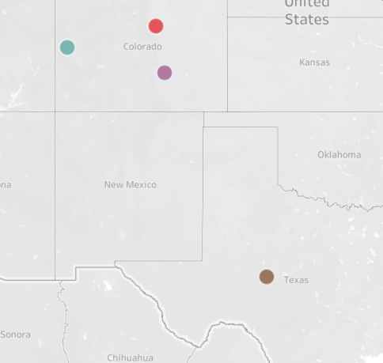
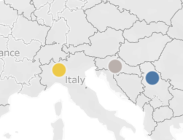
Final Recommendations
The final recommendation based on our temperature analysis is to further explore the market conditions and possible retail partners in 3 key locations:
San Angelo, TX
Milan, Italy
Grand Junction, CO
Notes:
The final recommendations for where to do some business investigation

Slide 19
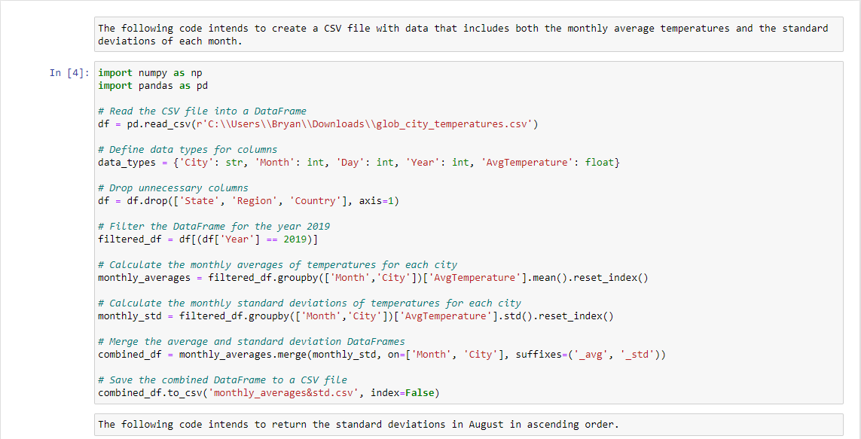

Slide 20
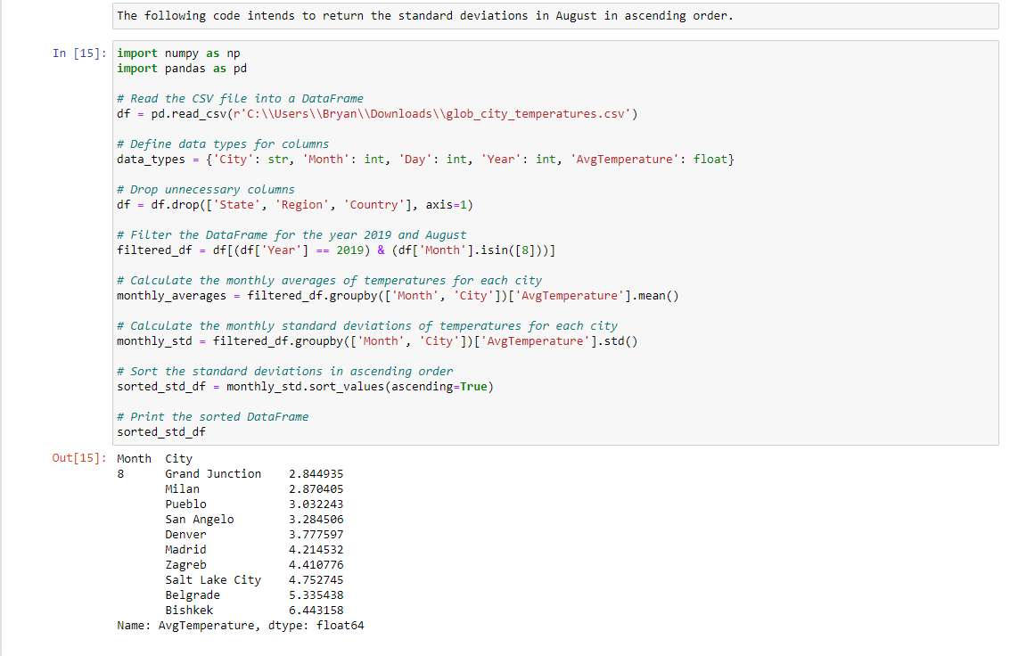

Slide 21
